Slide 1
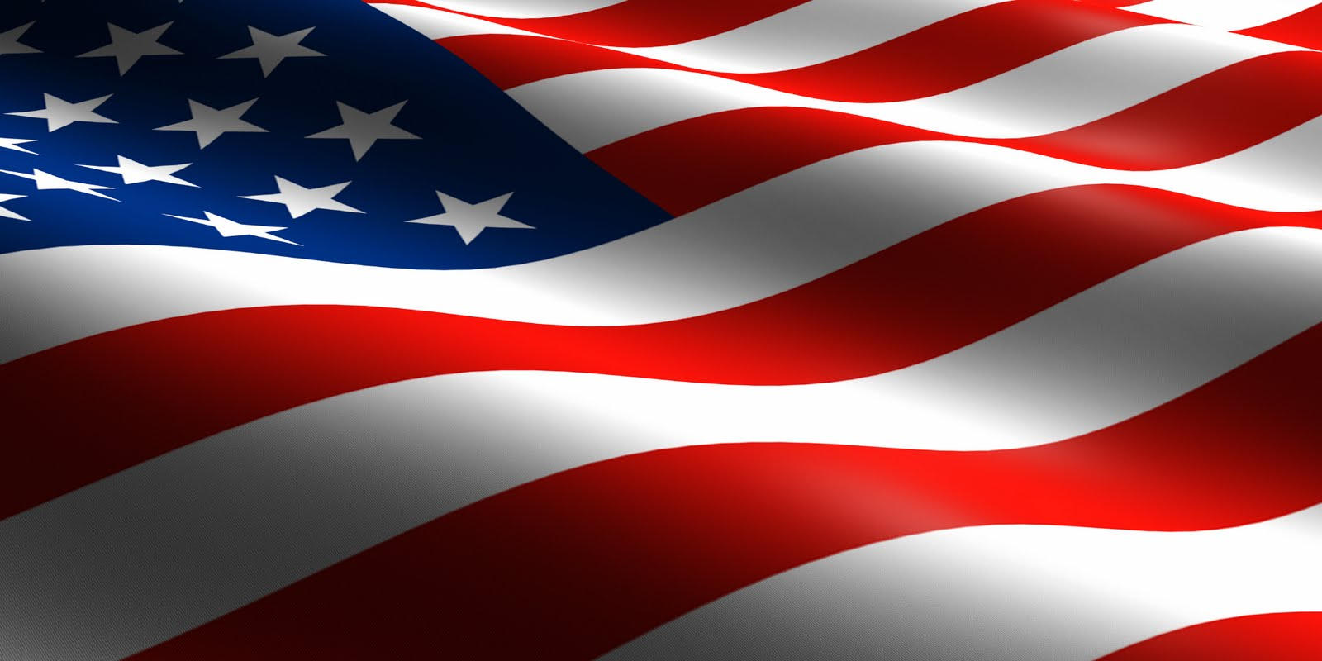
HOMETOWN HEROES
Council Member Al Ferraro
Interviews Jacksonville’s First African American
Oral And Maxillofacial Surgeon
Dr. Marvin Wells
about his experiences.
September 26, 2019
3:00 p.m.
City Hall, Council Chambers
117 West Duval Street
Jacksonville, Florida 32202

